Slide 1
Visitor Forecasting for
Restaurants
Ashwini Sayani-18210637
Geetha Rapalli-18210710
Monisri Rajendran-18210193
Nivedha Nagarajan-18210700

Slide 2
QUESTION?
How do we help restaurants achieve a good estimate of the number of visitors they can expect each day?

Slide 3

RESERVATION WEBSITE

Slide 4

RESERVATION SYSTEM (USED BY RESTAURANTS)

Slide 5
Data, a closer look!
2 Sources - Hot Pepper Gourmet (HPG) and AIR Reservation Board
7 Datasets
4690 Restaurants
125 Areas in Japan
35 Cuisines.
Features: Store ID, Cuisines, No. of Visitors, Date of Visit/Reservation, Holiday flag.

Slide 6
HOW DOES THE DATA ACTUALLY LOOK LIKE?

Slide 7
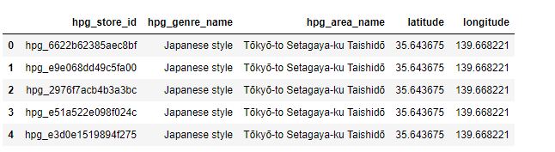
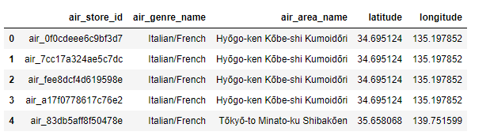
HPG and AIR - Restaurant Information

Slide 8
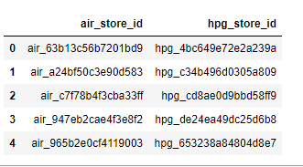
STORE ID RELATION - AIR AND HPG

Slide 9
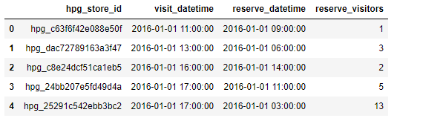
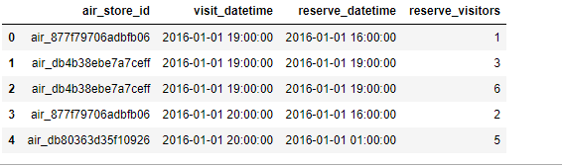
RESERVATION DATA - AIR AND HPG

Slide 10
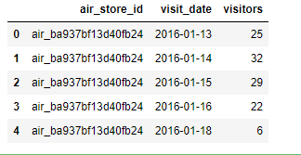
ACTUAL VISIT DATA FROM THE RESTAURANTS

Slide 11
DATA CLEANING

Slide 12
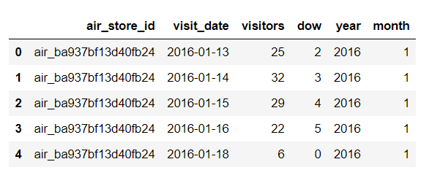
Null values, missing values
Merged datasets
map(), groupby(), encoder functions.
Stripped timestamp - date, day, time.
Removed duplicates

Slide 13
FEATURE EXTRACTION

Slide 14
Summary Statistics of Visitor Count
Day of Week column
Date-Time difference between Reservation and Visitation.
Latitude and Longitude features

Slide 15
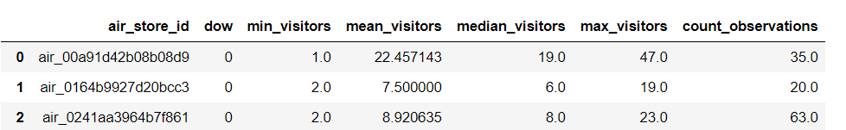
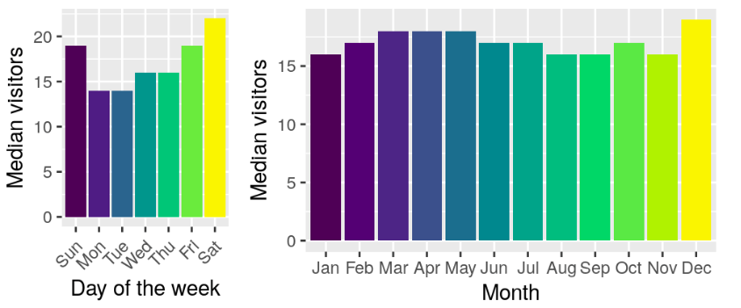
Screenshot of Summary Statistics Features

Slide 16
DATA MODELLING

Slide 17
Simple Feed Forward Neural network using Keras
Keras is a neural network library written in Python.
Implemented a sequential deep learning neural model.
The model contains three layers: Input, Hidden layer 1 and hidden layer 2
Training Data with shape is given to the input layer.
“ReLu” activation function is used in the model (Rectified Linear Activation)
Compiled the model using Adam optimizer and a loss function (mse)
rmsle score of 0.492( Root Mean squared Logarithmic Error) is obtained

Slide 18
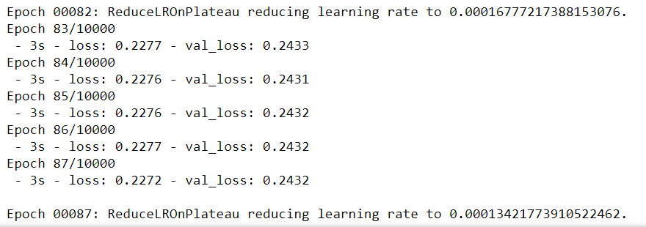
Training Data with epochs and loss values

Slide 19
K-Nearest Neighbors Regression Algorithm
Why?
Ease of interpretation and calculation
How?
Based on ‘feature similarity’, it predicts the value for the test point based on the average of the k-neighbor values.
Choosing the K-Value
Depends on the training and validation error for different ‘k’ values.
Chosen K-Value = 4, RMSLE = 0.419
ACCURACY:

Slide 20
Gradient Boosting Regressor
Ensemble method for improving the model predictions.
Can be explained in the following steps:
Fit a model to the data, F1(x) = y
Fit a model to the residuals, h1(x) = y - F1(x)
Create a new model, F2(x) = F1(x) + h1(x)
Test data is used to predict visitor count.
Id, air_store_id, visit_date, visitor are the main columns used in this method.
RMSLE value after using this method is 0.34

Slide 21
XGBoost Regressor
Extreme Gradient Boosting Algorithm
Gradient boosted decision trees are used to enhance the speed and performance
Efficient Memory Usage and Scalable
The feature extracted training data is given as input to the model and is trained .
The test data is used for prediction of the visitor count .
RMSLE is the evaluation metric used which is found to be 0.40288

Slide 22
PERFORMANCE EVALUATION
MODEL | RMSLE
Feed Forward Neural Networks | 0.492
K Nearest Neighbours | 0.419
Gradient Boosting | 0.347
XG Boost | 0.402

Slide 23
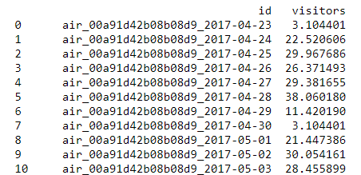
FINAL PREDICTION

Slide 24
CHALLENGES FACED:
Merging the dataset
Feature Extraction
Plotting and visualizing the extracted features

